Slide 1
Chapter 4:
Completing the Problem-Solving Process

Slide 2
Objectives
Get numeric and character data from the keyboard
Display information on the computer screen
Write arithmetic expressions
Type cast a value
Write an assignment statement
Code the algorithm into a program
Desk-check a program
Evaluate and modify a program

Slide 3
Finishing Step 4 in the Problem-Solving Process
The fourth step in the problem-solving process is to code algorithm into a program
Begin by declaring a memory location for each input, processing, and output value in IPO chart
Optionally initialize each value (highly preferred)
Next, you code the instructions for the algorithm

Slide 4
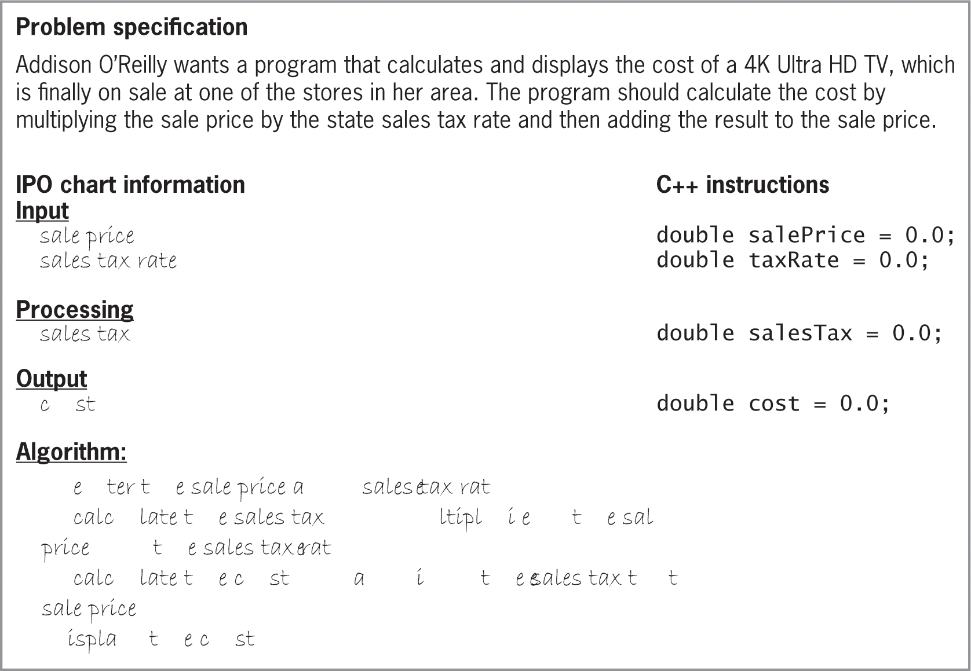
Finishing Step 4 in the Problem-Solving Process (cont’d.)
Figure 4-1 Problem specification, IPO chart
information, and variable declaration

Slide 5
Getting Data from the Keyboard
C++ uses stream objects to perform input/output operations
A stream is a sequence of characters
The cin object is used to obtain information from the keyboard (program pauses while user enters data)
The extraction operator (>>) takes information out of cin object and stores it in internal memory
Syntax: cin >> variableName;

Slide 6
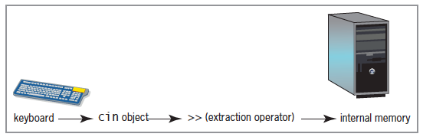
Getting Data from the Keyboard (cont’d.)
Figure 4-2 Relationship among the keyboard, cin object, extraction operator, and internal memory

Slide 7
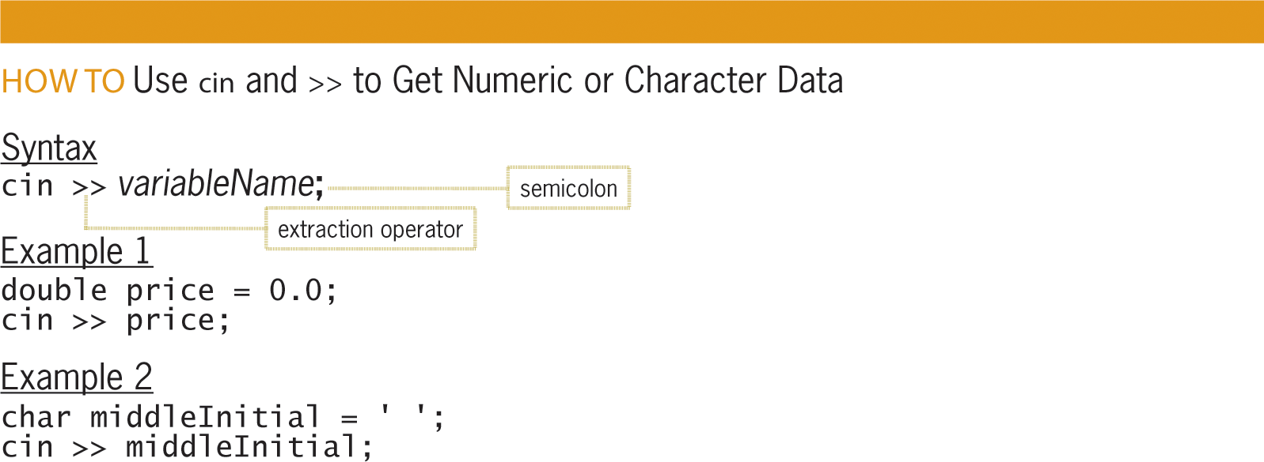
Getting Data from the Keyboard (cont’d.)
Figure 4-3 How to use cin and >> to
get numeric or character data

Slide 8
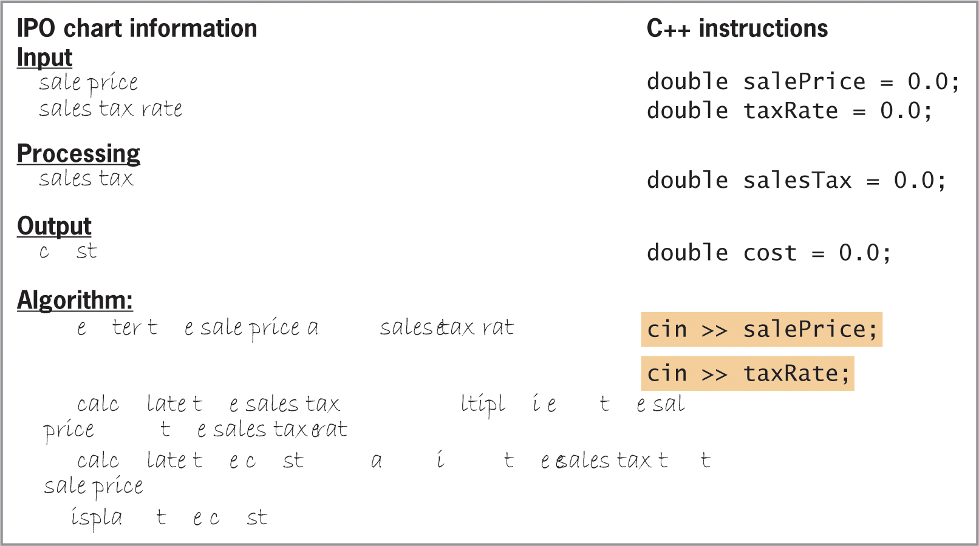
Getting Data from the Keyboard (cont’d.)
Figure 4-4 Input statements for
the Addison O’Reilly problem

Slide 9
Displaying Messages on the Computer Screen
You use a prompt (message) to let the user know what data is to be entered
The cout object is used with the insertion operator (<<) to display information on the screen
Information can be any combination of literal constants, named constants, and variables
Multiple items can be printed in the same statement
Syntax: cout << item1 [<< item2 << itemN];
Part in brackets is optional

Slide 10
Displaying Messages on the Computer Screen (cont’d.)
A stream manipulator is used to manipulate (manage) the characters in an input or output string
endl is a stream manipulator that advances the cursor to the next line on the screen
Equivalent to pressing the Enter key
(carriage return and line feed)

Slide 11
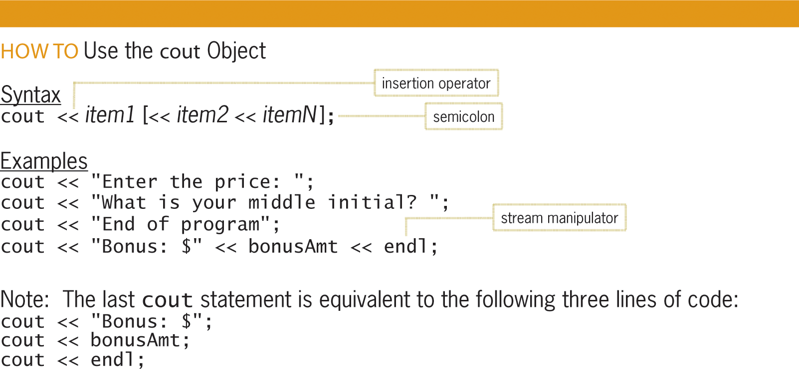
Displaying Messages on the Computer Screen (cont’d.)
Figure 4-5 How to use the cout object

Slide 12
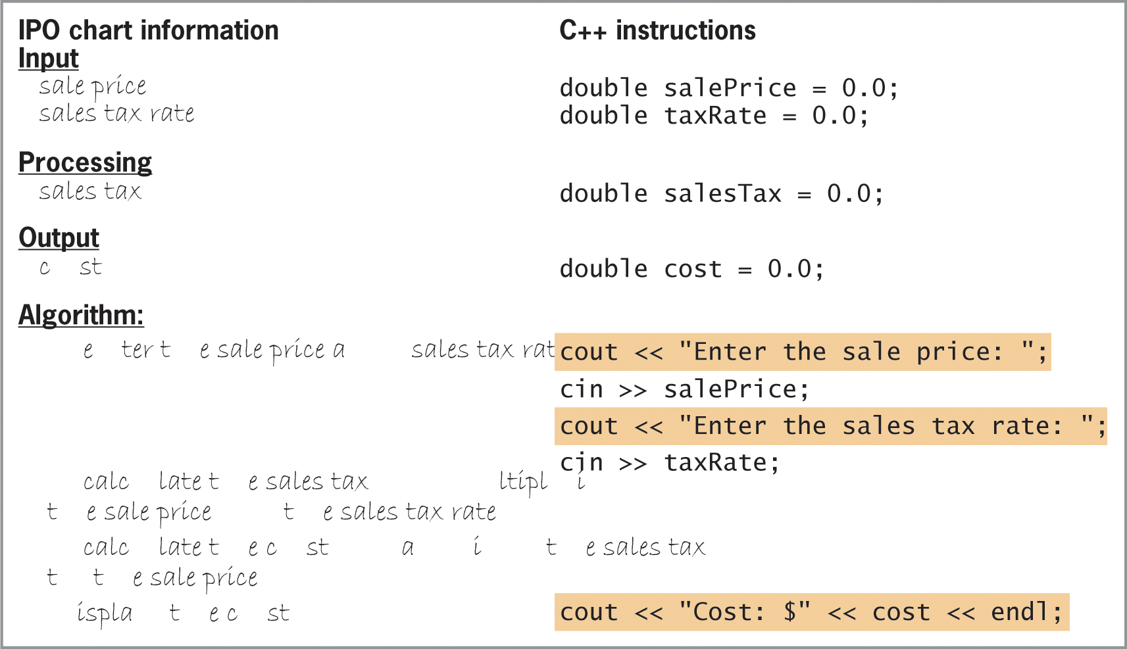
Displaying Messages on the Computer Screen (cont’d.)
Figure 4-6 Prompts and output statement
for the Addison O’Reilly problem

Slide 13
Arithmetic Operators in C++
You can evaluate arithmetic expressions in C++ using arithmetic operators
Operators are negation (-), addition (+), subtraction (-), multiplication (*), division (/), and modulus (%)
Negation and subtraction use the same symbol, but negation is a unary operator (one operand) and subtraction is a binary operator (two operands)
Modulus gives remainder when dividing two integers

Slide 14
Arithmetic Operators in C++ (cont’d.)
Each operator has a precedence: determines in which order operators in an expression are evaluated
Operators with lower-precedence numbers are evaluated before higher ones
Parentheses have lowest-precedence number, so they can be used to override precedence order
Operators with the same precedence number are evaluated from left to right

Slide 15
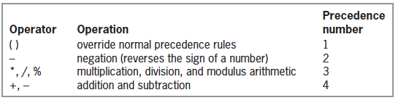
Arithmetic Operators in C++ (cont’d.)
Figure 4-7 Standard arithmetic operators and their order of precedence

Slide 16
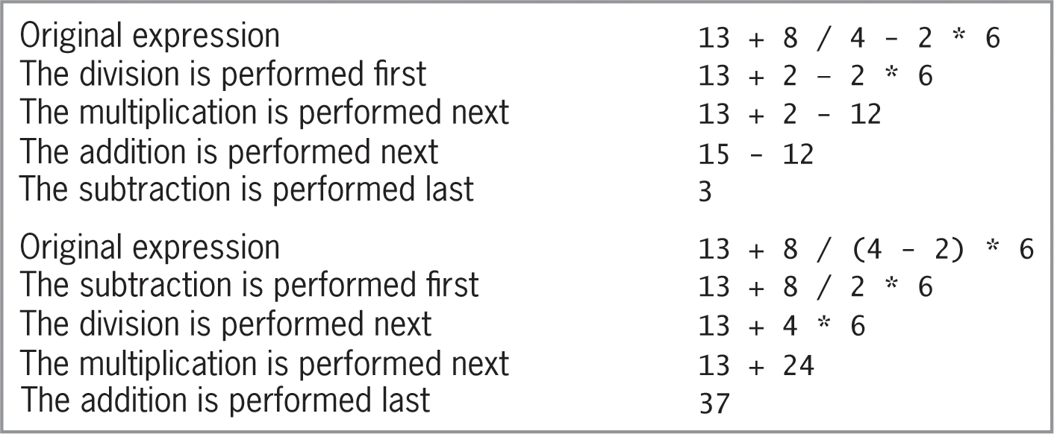
Arithmetic Operators in C++ (cont’d.)
Figure 4-8 Expressions containing more than one operator having the same precedence

Slide 17
Type Conversions in Arithmetic Expressions
Recall that the compiler will implicitly promote or demote data types to match when possible
Sometimes it is necessary to explicitly cast from one data type into another
Example: dividing two integers gives the result of integer division (no remainder), but you would really like a double result
If one or both of the integers is a literal, you can cast it to a double by adding .0 to the end of it
If both are variables, you must use the static_cast operator

Slide 18
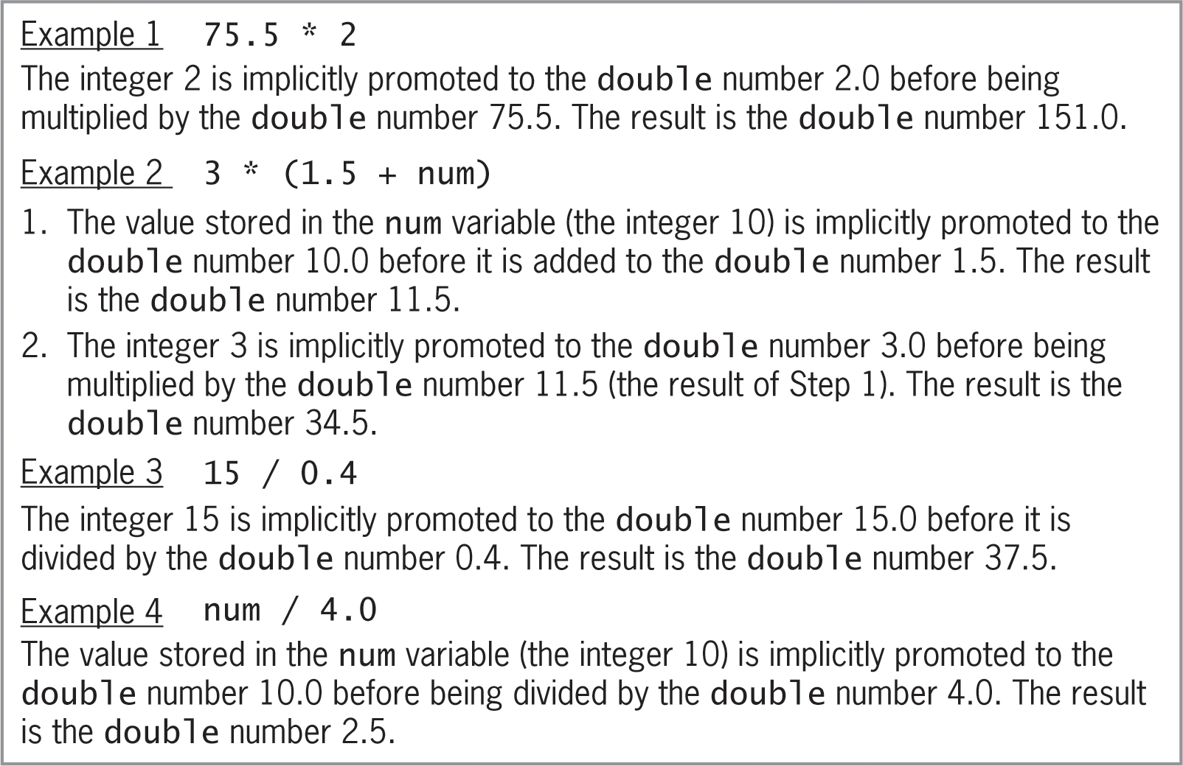
Type Conversions in Arithmetic Expressions (cont’d.)
Figure 4-9 Examples of expressions that
require implicit type conversions

Slide 19
The static_cast Operator
Used to explicitly convert data from one data type to another
Called an explicit type conversion or type cast
Syntax: static_cast<dataType>(data)
data can be a literal constant, named constant, or variable
dataType is the data type to which you want the data converted

Slide 20
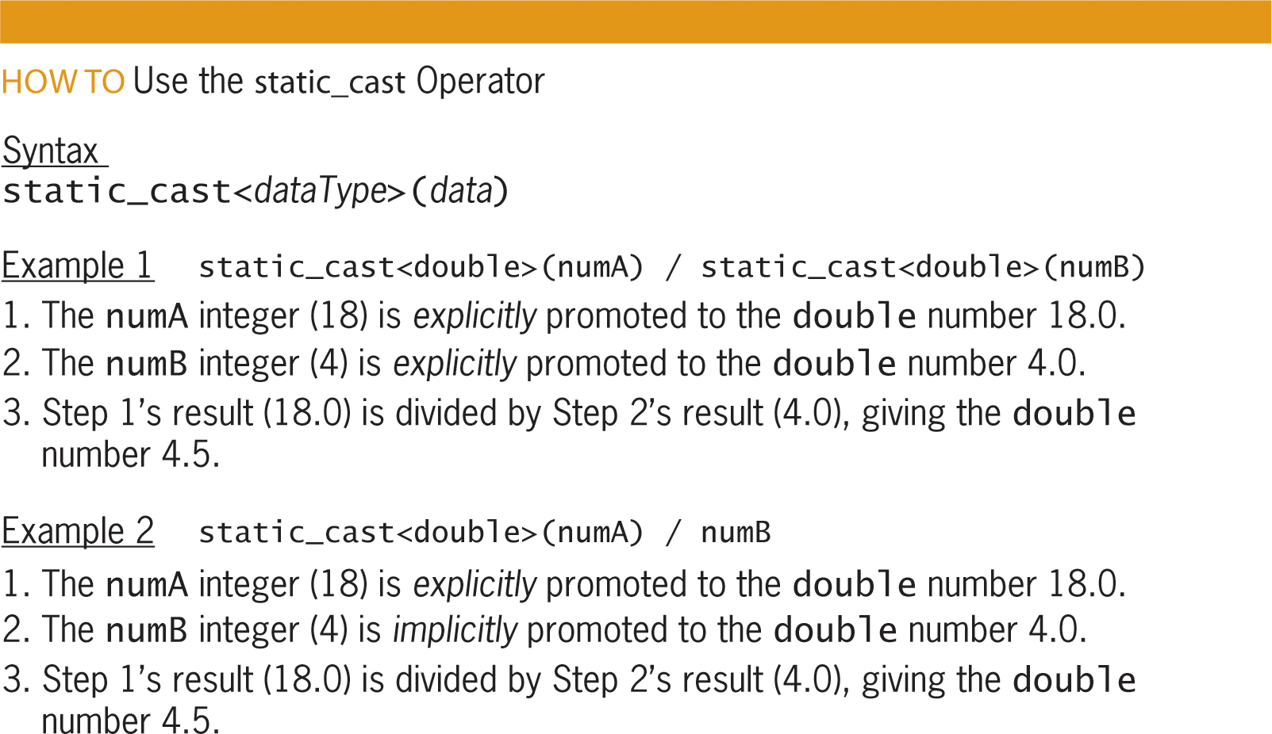
The static_cast Operator (cont’d.)
Figure 4-10 How to use the static_cast operator

Slide 21
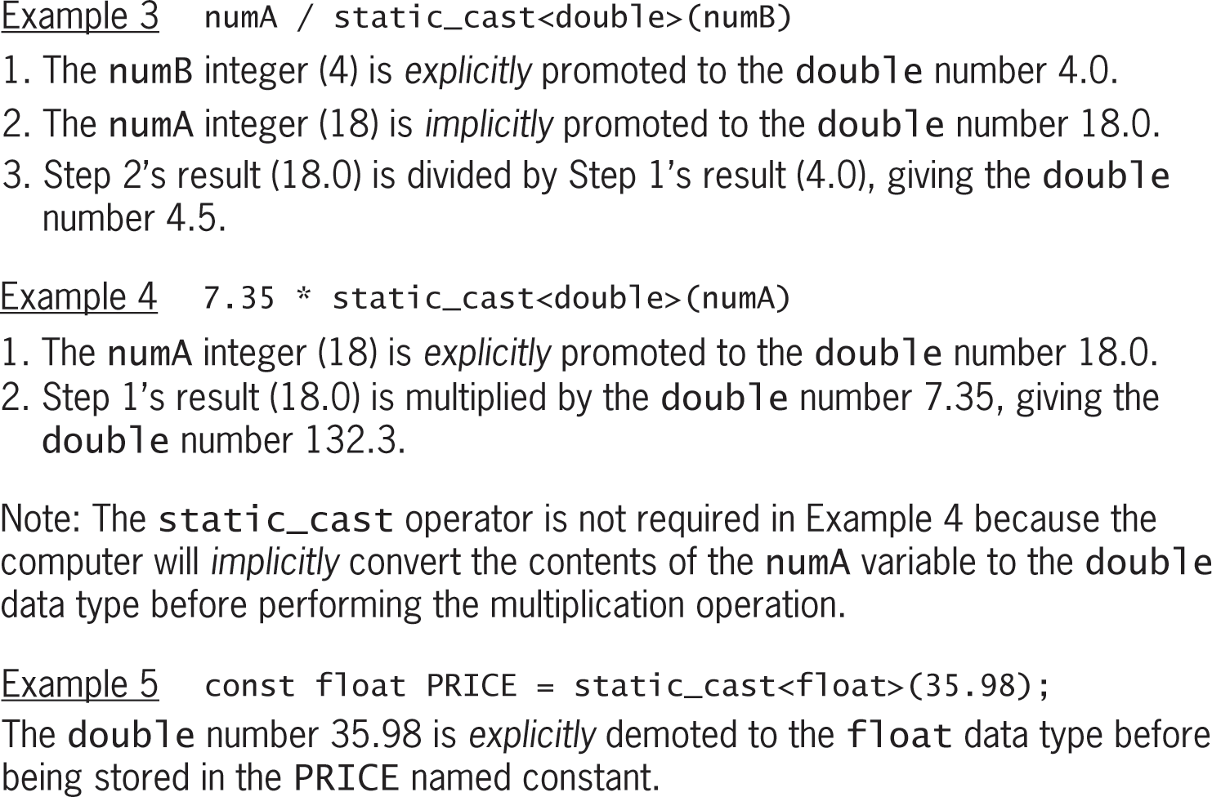
The static_cast Operator (cont’d.)
Figure 4-10 How to use the static_cast operator (cont’d.)

Slide 22
Assignment Statements
You use an assignment statement to assign a value to a variable while a program is running
Syntax: variableName = expression
The = symbol is the assignment operator
Tells computer to evaluate expression on right side of assignment operator and store result in variable on left side of the operator
expression can include one or more literal constants, named constants, variables, or arithmetic operators

Slide 23
Assignment Statements (cont’d.)
Data type of expression in an assignment statement must match data type of the variable
If they don’t match, compiler will use implicit type casting to get them to match
Doesn’t always produce correct result
Better to explicitly cast to correct data type yourself
Remember:
Declaration statement creates a new variable
Assignment statement assigns a new value to an existing variable

Slide 24
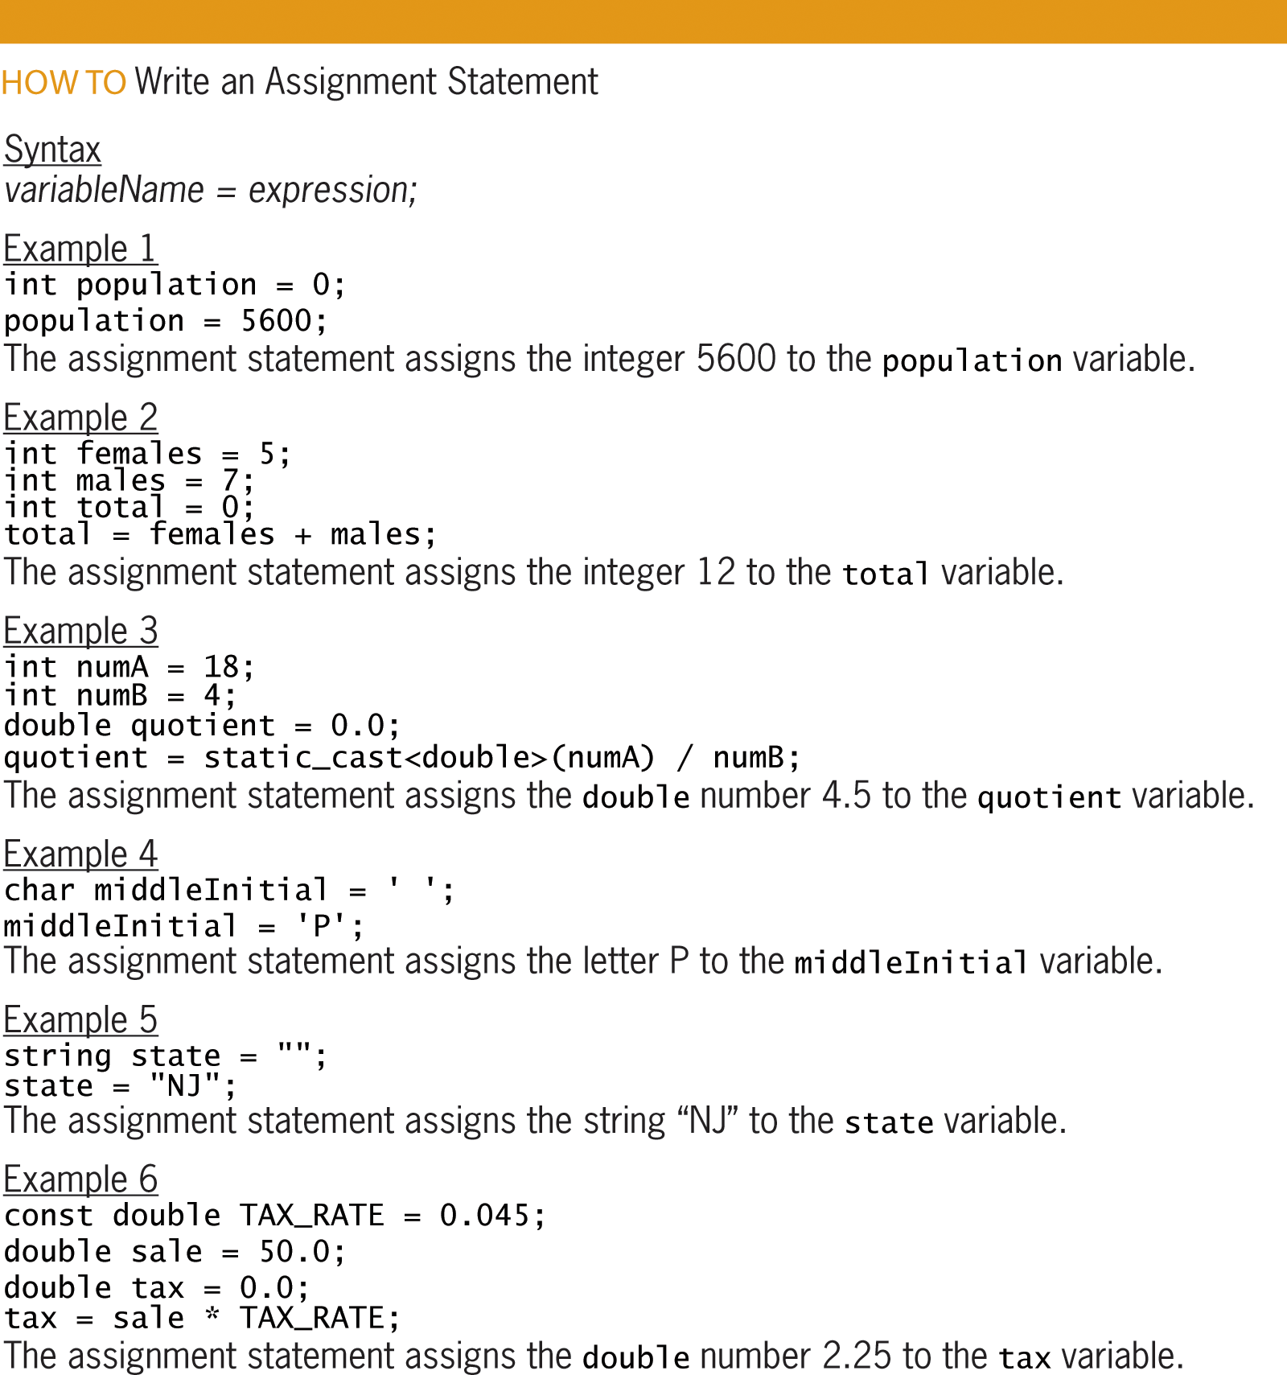
Assignment Statements (cont’d.)
Figure 4-11 How to write an assignment statement

Slide 25
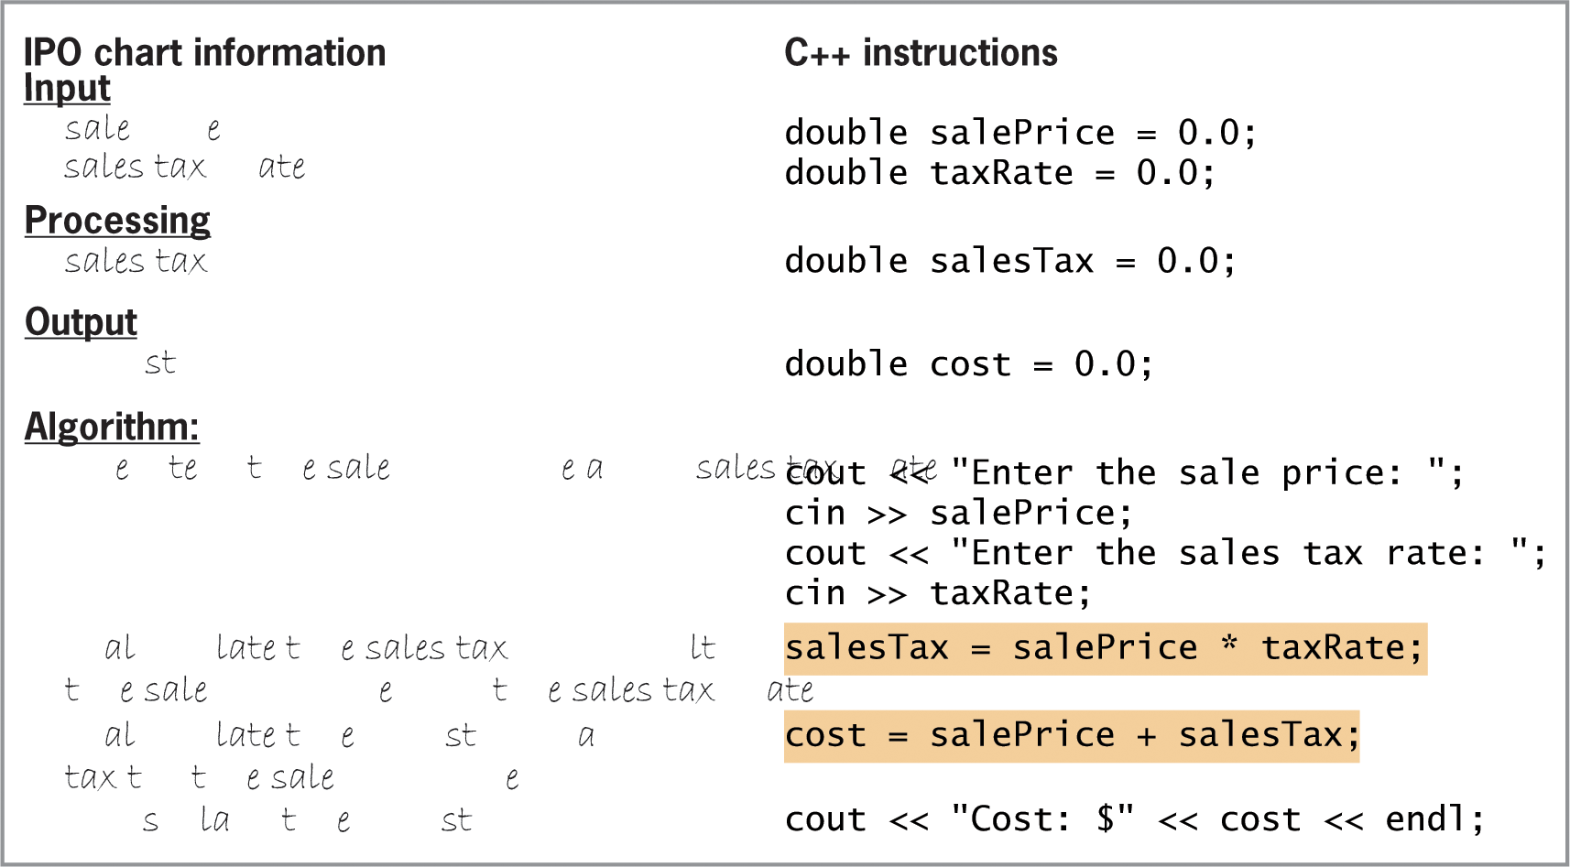
Assignment Statements (cont’d.)
Figure 4-12 Calculation statements
for the Addison O’Reilly problem

Slide 26
Arithmetic Assignment Operators
Allow you to abbreviate assignment statements that contain an arithmetic operator
Statement must be of the form variableName = variableName arithmeticOperator value
Abbreviated as variableName arithmeticOperator = value
Example: price = price*1.05; can be abbreviated as price *= 1.05;
Most common operators are += , -= , *= , /= , and %=

Slide 27
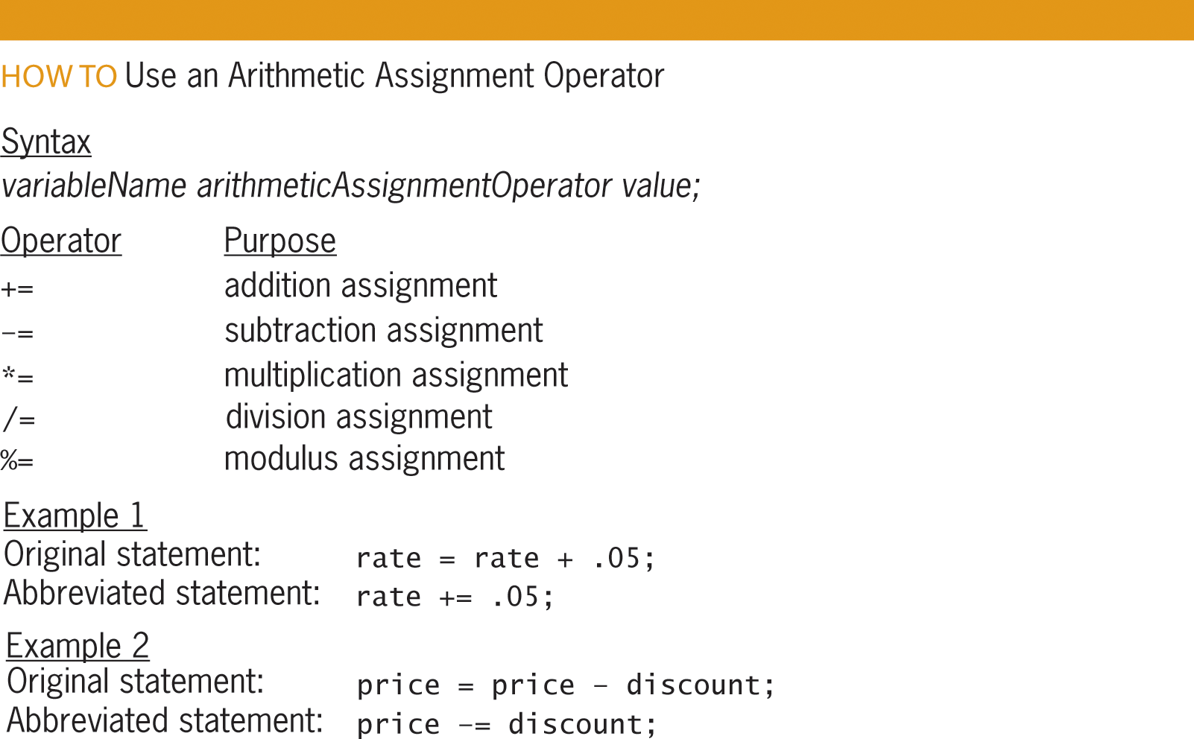
Arithmetic Assignment Operators (cont’d)
Figure 4-13 How to use an arithmetic assignment operator

Slide 28
Step 5–Desk-Check the Program
Fifth step is to desk-check the program to make sure instructions were translated correctly
You should desk-check the program using sample data used to desk-check the algorithm
Results of both desk-checks should be the same
First, place names of the declared memory locations in a new desk-check table along with each memory location’s initial value
Next, desk-check remaining C++ instructions in order, recording any changes made to the variables

Slide 29
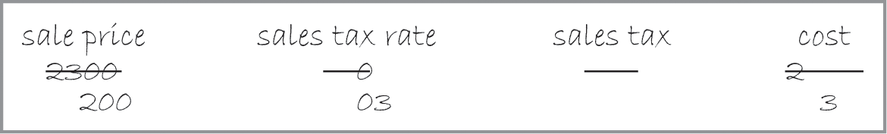
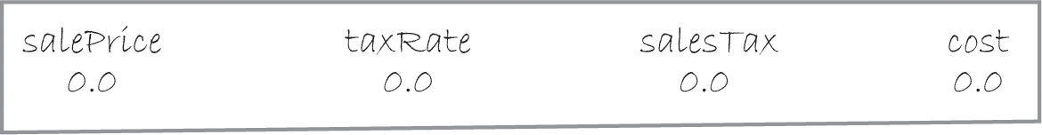
Step 5–Desk-Check the Program (cont’d.)
Figure 4-14 Algorithm’s desk-check table from Chapter 2
Figure 4-15 Variable names and initial values entered in the program’s desk-check table

Slide 30
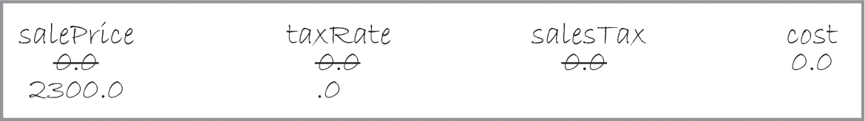
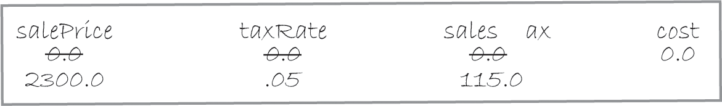
Step 5–Desk-Check the Program (cont’d.)
Figure 4-16 Input values entered in the program’s desk-check table
Figure 4-17 Sales tax amount entered in the desk-check table

Slide 31
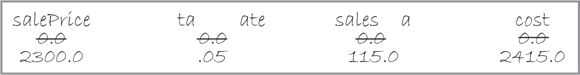
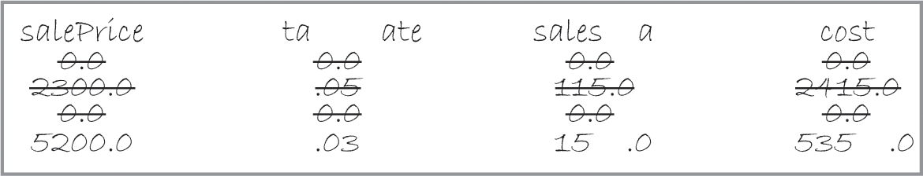
Step 5–Desk-Check the Program (cont’d.)
Figure 4-18 Cost amount entered in the desk-check table
Figure 4-19 Program’s desk-check table showing the results of the second desk-check

Slide 32
Step 6–Evaluate and Modify the Program
Final step in the problem-solving process
You evaluate a program by running the program on the computer and entering the sample data used when desk-checking the program
If evaluation reveals errors (known as bugs), they must be fixed
Process of locating and fixing errors is called debugging
Two types of bugs: syntax errors and logic errors

Slide 33
Step 6–Evaluate and Modify the Program (cont’d.)
Syntax errors result from breaking programming language’s rules; cause compiler errors
Logic errors don’t cause compiler errors; can be hard to identify
Example: entering instructions in the wrong order
Need a text editor to enter C++ instructions
Instructions are called source code and are saved in source files with extension .cpp
Need a compiler to translate source code into machine code (also called object code)

Slide 34
Step 6–Evaluate and Modify the Program (cont’d.)
Compiler saves object code in object files with extension .obj
Linker combines .obj files with other machine code necessary to run the program and produces an executable file with extension .exe
An IDE (integrated development environment) is a development tool that contains both an editor and compiler
A command-line compiler contains only the compiler and requires a separate editor to enter source code

Slide 35
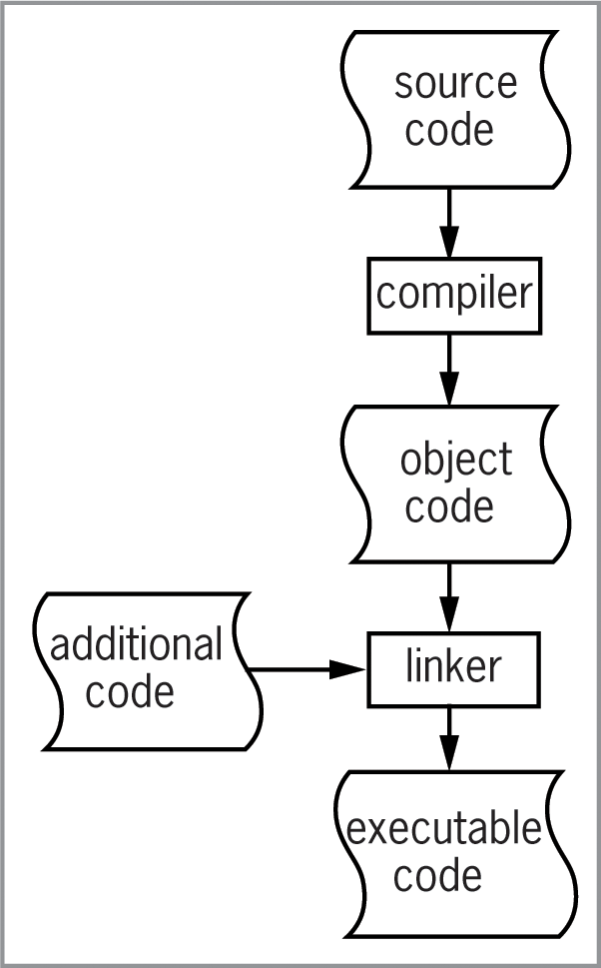
Step 6–Evaluate and Modify the Program (cont’d.)
Figure 4-20 Process by which source code
is translated into executable code

Slide 36
Step 6–Evaluate and Modify the Program (cont’d.)
A comment is a form of internal documentation; written by placing // in front of the comment text
Ignored by the compiler
Considered good programming practice; makes code more readable
A #include directive allows you to merge the source code in one file with that in another file
The #include <iostream> is required when using the cin or cout stream objects
Not a statement, so no semicolon needed at the end

Slide 37
Step 6–Evaluate and Modify the Program (cont’d.)
A using directive tells the compiler where in internal memory it can find definitions of C++ keywords and classes like double or string
The using namespace std; directive indicates that the definitions of the standard C++ keywords and classes are located in the std (standard) namespace
Is a statement, so semicolon required at the end
A namespace is a special area in internal memory

Slide 38
Step 6–Evaluate and Modify the Program (cont’d.)
A function is a block of code that performs a task
Functions have parentheses following their name (Example: main())
Some functions require information between the parentheses; others do not
Every C++ program has one (and only one) main function; this is where program execution begins
Some functions return a value, and the data type they return appears to the left of the function name
Example: int main()

Slide 39
Step 6–Evaluate and Modify the Program (cont’d.)
Other functions do not return a value, and void appears to the left of the function name
The return type, name, and parameters (information in parentheses) constitute the function header, which marks the beginning of the function
After the function header, you enter the function’s code
You enclose a function’s code in a set of braces ({})
The code between the braces is called the function body

Slide 40
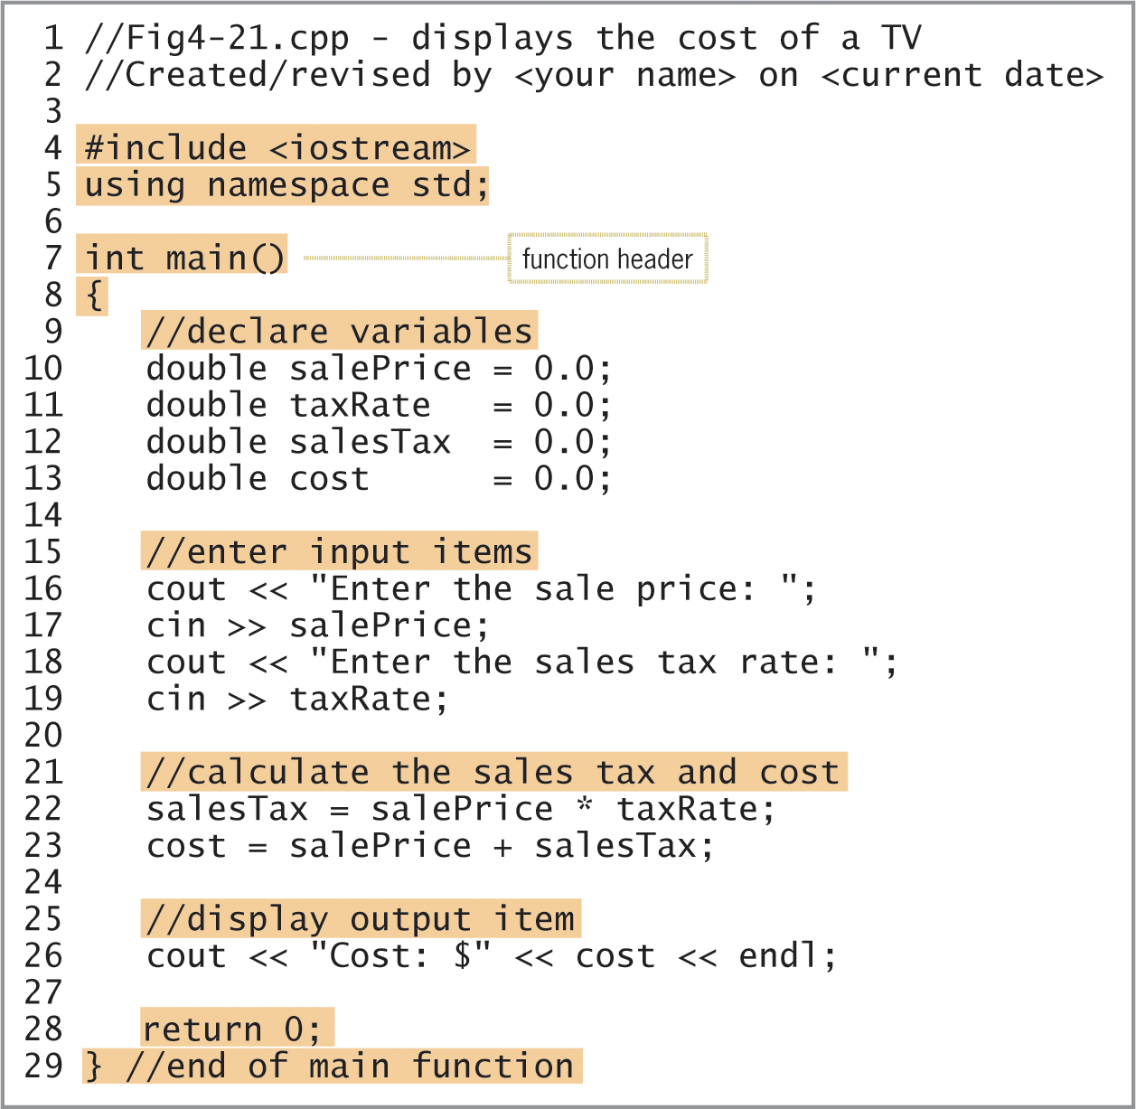
Step 6–Evaluate and Modify the Program (cont’d.)
Figure 4-21 Addison O’Reilly program

Slide 41
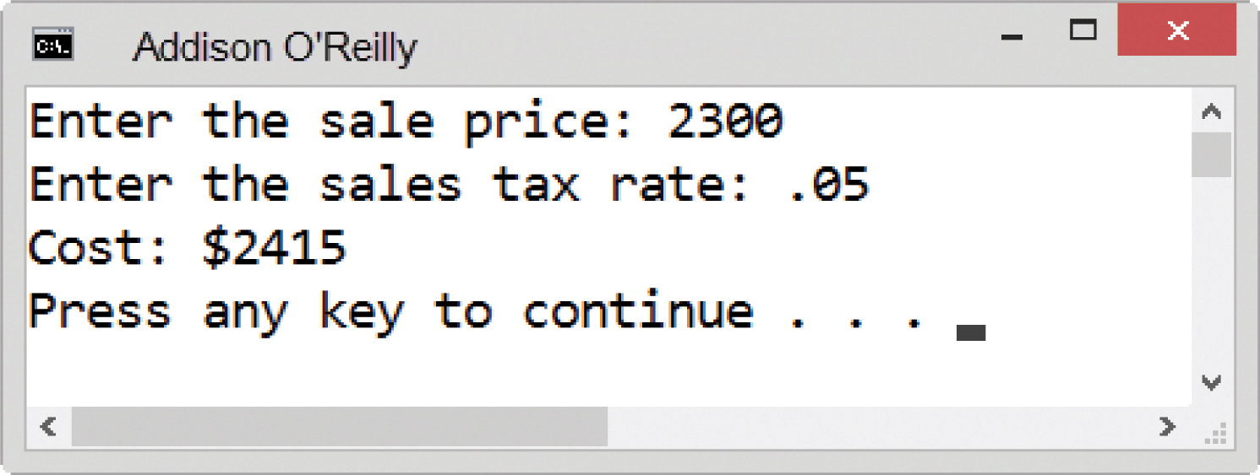
Step 6–Evaluate and Modify the Program (cont’d.)
Figure 4-22 Command Prompt window

Slide 42
Summary
Fourth step in problem-solving process is coding the algorithm into a program
C++ uses stream objects for standard input/output operations
Use cin with extraction operator (>>) to get numeric or character data from the keyboard
Use cout with insertion operator (<<) to display information on the screen
The endl stream manipulator advances cursor to next line

Slide 43
Summary (cont’d.)
You do calculations by writing arithmetic expressions using arithmetic operators
Each operator has a precedence: determines the order of evaluation in an expression
Parentheses are used to override this order
Compiler implicitly casts data types when possible, but you should explicitly cast to ensure correctness
Use the static_cast operator to explicitly cast variables from one data type to another

Slide 44
Summary (cont’d.)
An assignment statement assigns a value to a variable during runtime
The expression on the right side of the assignment operator (=) in an assignment statement is stored in the variable on its left
Fifth step of the problem-solving process is to desk-check the program using the same data used to desk-check the algorithm
The sixth step is to evaluate and modify (if necessary) the program

Slide 45
Summary (cont’d.)
Errors (called bugs) can either be syntax errors or logic errors
You need a text editor and compiler to enter C++ instructions and compile them into a program
C++ instructions are called source code and are saved in source files with the extension .cpp
The compiler translates source code into machine code, also called object code
A linker produces an executable file that contains all machine code necessary to run a C++ program

Slide 46
Summary (cont’d.)
Programmers use comments to document a program internally
Comments are not processed by the compiler
The #include <filename> directive allows you to include multiple source files in a program
The using namespace std; directive tells the compiler where definitions of standard C++ keywords and classes are in internal memory
A namespace is a special area in the computer’s internal memory

Slide 47
Summary (cont’d.)
Execution of every C++ program begins with the main() function
The first line of a function is the function header
The function body follows the header and is enclosed in braces
Some functions return a data type; others return void
Arithmetic assignment operators can be used to abbreviate certain assignment statements with arithmetic operators in them

Slide 48
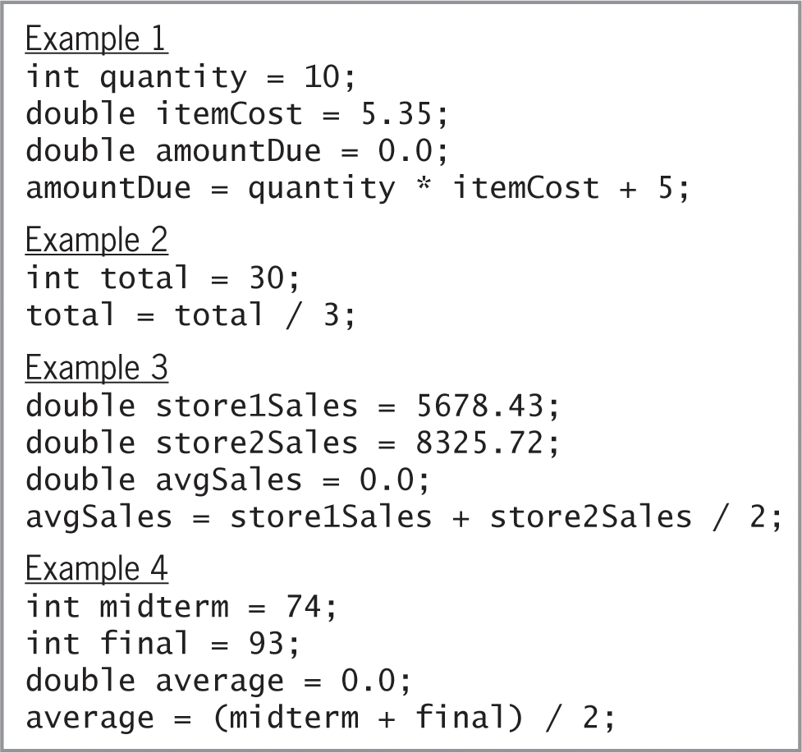
Lab 4-1: Stop and Analyze
Figure 4-23 Examples for Lab 4-1

Slide 49
Lab 4-2: Plan and Create
In Chapter 3’s Lab 3-2, you planned, created, and desk-checked an algorithm that displays 10% commission on a sales amount. Figure 4-24 shows the algorithm, along with the input and output items and their corresponding C++ statements. It also includes the desk-check table you completed in Lab 3-2.
Figure 4-25 shows the completed IPO chart and C++ instructions for Lab 4-2.
Figure 4-27 shows the completed commission program.

Slide 50
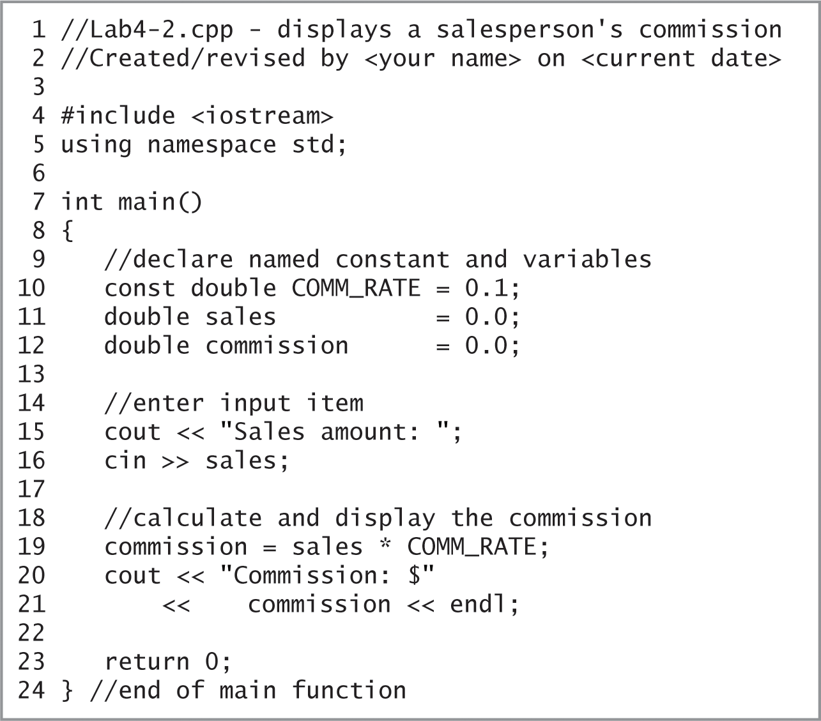
Lab 4-2: Plan and Create (cont’d.)
Figure 4-27 Commission program

Slide 51
Lab 4-3: Modify
Modify the program in Lab 4-2 to allow the user to enter the commission rate (in decimal form).
Test the program twice. For the first test, use 1328.50 and .1 as the sales amount and commission rate. For the second test, use 267.90 and .15.

Slide 52
Lab 4-4: What’s Missing?
The program in this lab should calculate and display the volume of a cylinder, given the cylinder’s radius (r) and height (h), and using 3.14 as the value of pi.

Slide 53
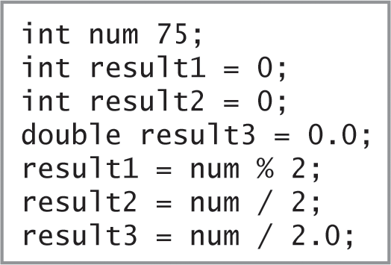
Lab 4-5: Desk-Check
Desk-check the seven lines of code shown in Figure 4.28 below

Slide 54
Lab 4-6: Debug
Following the instructions for Lab 4-6. The program should calculate and display the area of a triangle, but it is not working properly. Run and debug the program.

